Slide 1
secure data hiding in images using steganography
CAPSTONE PROJECT
Presented By
Student Name : Sai Prayag Dasari
College Name & Department : Indira college of commerce & science, Department of cybersecurity, Pune

Slide 2
OUTLINE
Problem Statement
Technology used
Wow factor
End users
Result
Conclusion
Git-hub Link
Future scope

Slide 3
Problem Statement
Hiding secret messages inside images securely.
Avoiding detection while storing confidential data.
Using a simple and efficient algorithm for encryption & decryption.
There is a growing need for secure communication methods to prevent unauthorized access to sensitive information.

Slide 4
Technology used
Libraries: OpenCV, OS,string
Programming Language: Python
File Formats: JPG
system: Windows

Slide 5
Wow factors
Invisible Message Encoding – The hidden message is seamlessly embedded within the image pixels, making it undetectable to the naked eye.
Uses efficient OpenCV operations, ensuring quick encryption and decryption without requiring high-end hardware.
No Significant Image Quality Loss – Unlike some steganography methods that distort images, this project maintains near-original image quality.

Slide 6
End users
Cybersecurity Professionals – Security analysts and ethical hackers can use image steganography for covert communication and secure data storage.
Military & Government Agencies – Used for transmitting classified information securely while minimizing the risk of interception.
Individuals Seeking Privacy – Everyday users who want to protect their personal messages from unauthorized access can use this tool to share hidden information discreetly.

Slide 7
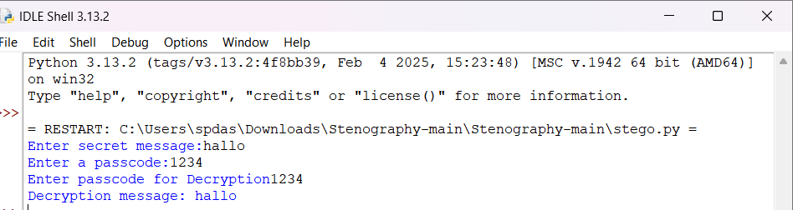
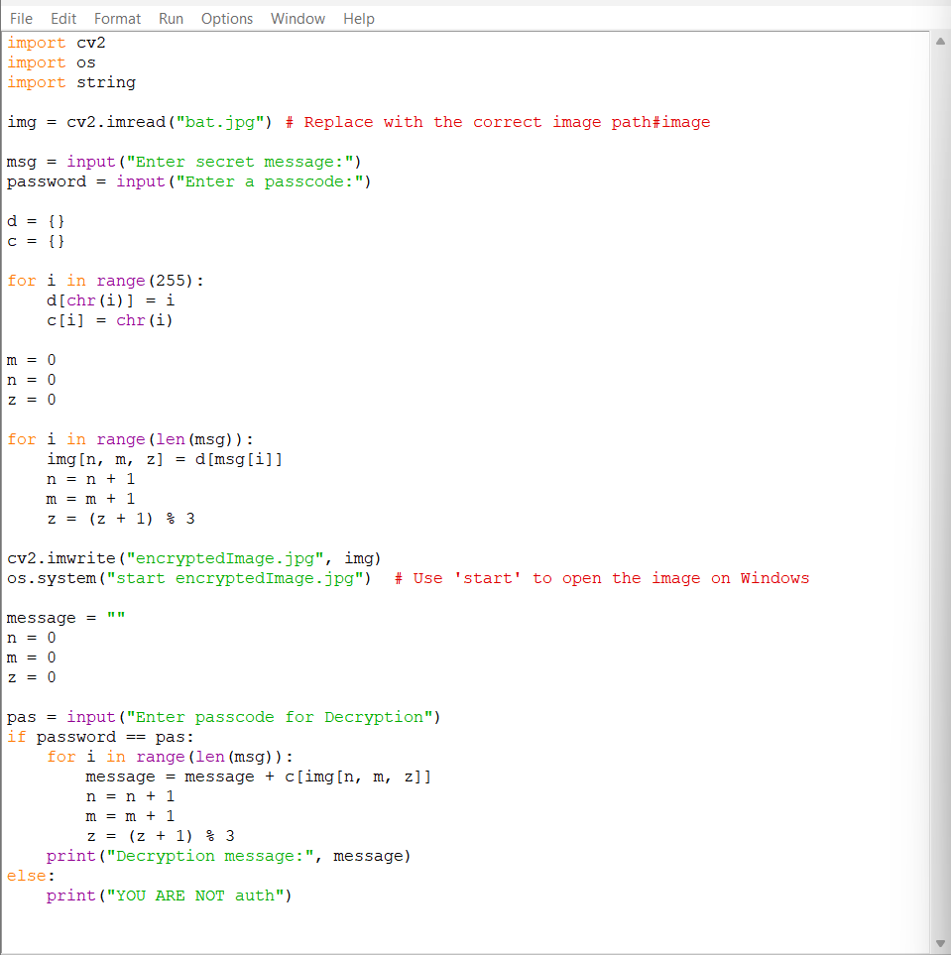

Results

Slide 8
Conclusion
Achieved Secure Message Hiding – Successfully implemented a steganography technique to hide and retrieve messages within images.
Maintained Image Integrity – The encryption process embeds the message without significantly altering the visual quality of the image.
Enhanced Security with Passcode Protection – The decryption process is safeguarded by a passcode, adding an extra layer of security.

Slide 9
GitHub Link
https://github.com/PrayagD80/myproject_aicte.git

Slide 10
Future scope(optional)
Supporting video steganography.
Enhancing error detection for corrupted images.

Slide 11
THANK YOU

